Slide 1
How to make BIOMEDICAL RESEARCH IN SPACE
Ahood Alnaim , grade 11
Ibn alrshd international school- qurtubah
Notes:
Greetings all,
Im Ahood and Today im gonna present to u our project named BIOMEDICAL RESEARCH IN SPACE at MOLECULAR BIOMEDICINE DEPARTMENT
ME, REMAS AND TULIN going to play role as scientist, technician and astronaut in this journey I hope u enjoy our talk.

Slide 2
When astronauts go to space many things in their body may change and they will be in a risk of many diseases, that’s epwhy we make medical space research’s to protect their health.
To do these research’s in space we have to go through different tests to prepare experiments for space .
Notes:
Regulation of inflammatory signaling in human cell maintained by different pathways. mitogen-activated protein kinases (MAPKs) is one of the cascades that have been activated when the cell is affected by stress stimuli as LPS.
LPS or lipo-poly-saccharides is mimicking the bacterial infection in the cells.
Thus, this pathway is target for many inflammatory disorders.

Slide 3
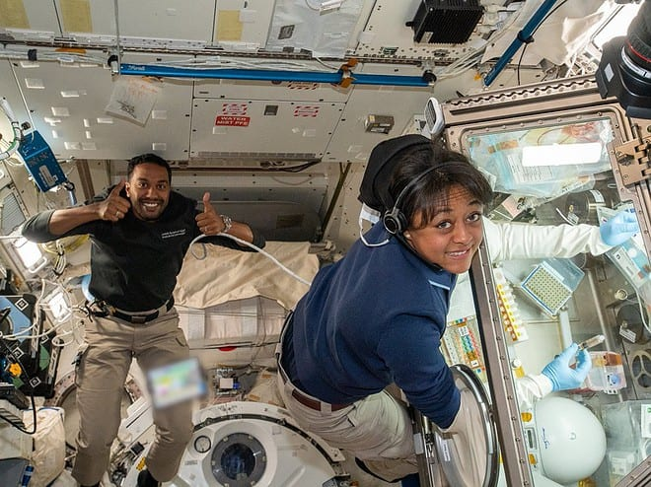
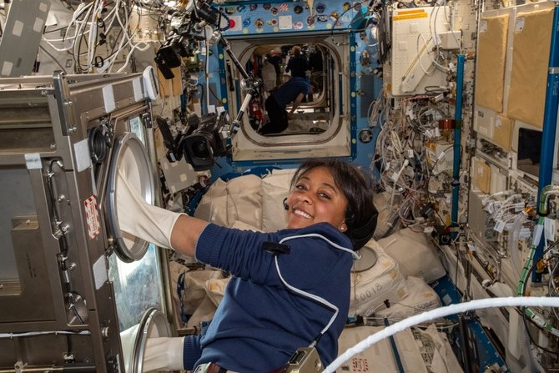
Getting ready for space
Notes:
To get ready for space experiments there different and many optimization and validation test depend on the experiment design to be run in ISS.

Slide 4
Validation tests
Treatment Stability
Cell Viability
Sample Storage Test
Notes:
In our project we needed to run 3 validation tests :

Slide 5
Treatment Stability
Aim:
is to study the effectiveness and activity of treatment when shipped to the ISS .
Objective :
prepare treatment stock and store at 4degree for different days
Notes:
For my part of this project, I did the ….

Slide 6
Protocol
Stock preparation
Extract RNA and Run qPCR
Store at 4℃
Add treatment to the cells
Prepare treatments stock: LPS, MK2I and DMSO at specific concentrations.
Store the treatments at 4℃ for specified days (0, 1, 4 and 7)
Collect all the treatments from 4℃ and treat the cells after seeding in 12-well plate.
Check the TNF-a expression level in the cells using qPCR.
Notes:
And the protocol to run this test is done through these steps:

Slide 7
Cell viability test
Aim : to know how many days cells may live in space after the beginning of the mission.
Notes:
Quantitative reverse transcription polymerase chain reaction is used to detect and quantify RNA.
Total RNA first transcribed into complementary DNA (cDNA). The cDNA is then used as the template for the quantitative PCR or real-time PCR reaction (qPCR) in thermocycler machine.

Slide 8
Protocol
Cell culture, freezing media preparation
Cell freezing -80C
Remove cells from -80C and store at liquid nitrogen (LN2) overnight
Measure viability
Remove cell vial day1 from LN2 back to -80C°
Remove cell vial day5 from LN2 back to -80C
Remove cell vial day8 from LN2 back to -80C°
Notes:
اشرحي بطريقتك الجميلة

Slide 9
Samples storage test
Aim : to test the period the experiment can last in space and to determine the best temperature for storing.

Slide 10
Protocol
Collect cells in to RNAlater vials and store in RT,4C,-20C,-80C
CELL CULTURE Split the cells
Seed cells leave O/N
Extract RNA for 1 day
Quantitate
Extract RNA for 5 days
Quantitate
Quantitate and run ALL SAMPLE on gel
Extract RNA for 8 days

Slide 11
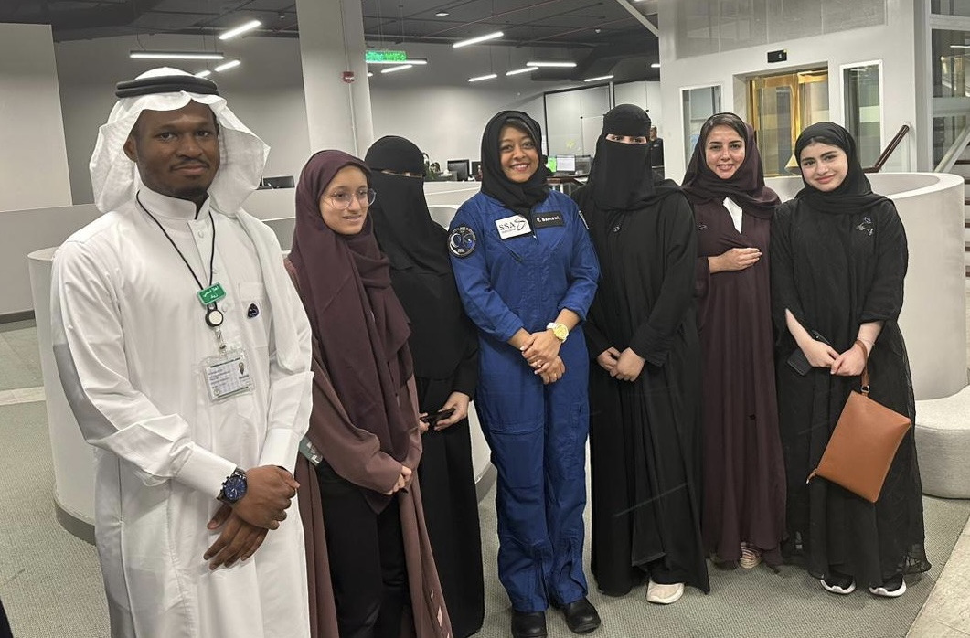
Pictures when I saw the Saudi astronauts

Slide 12
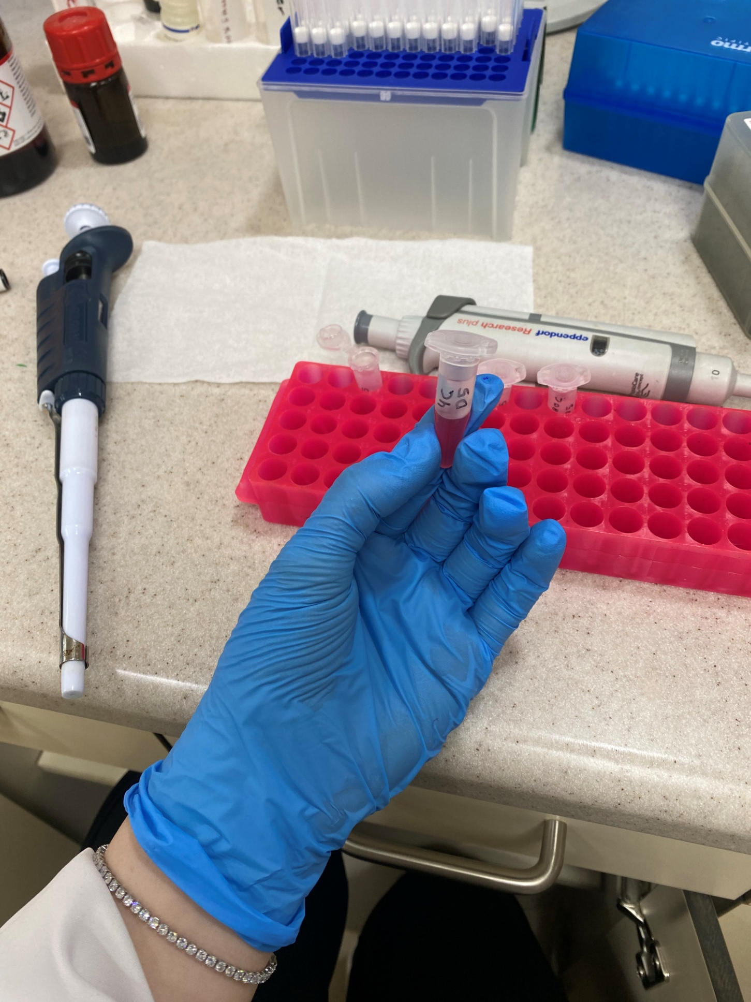
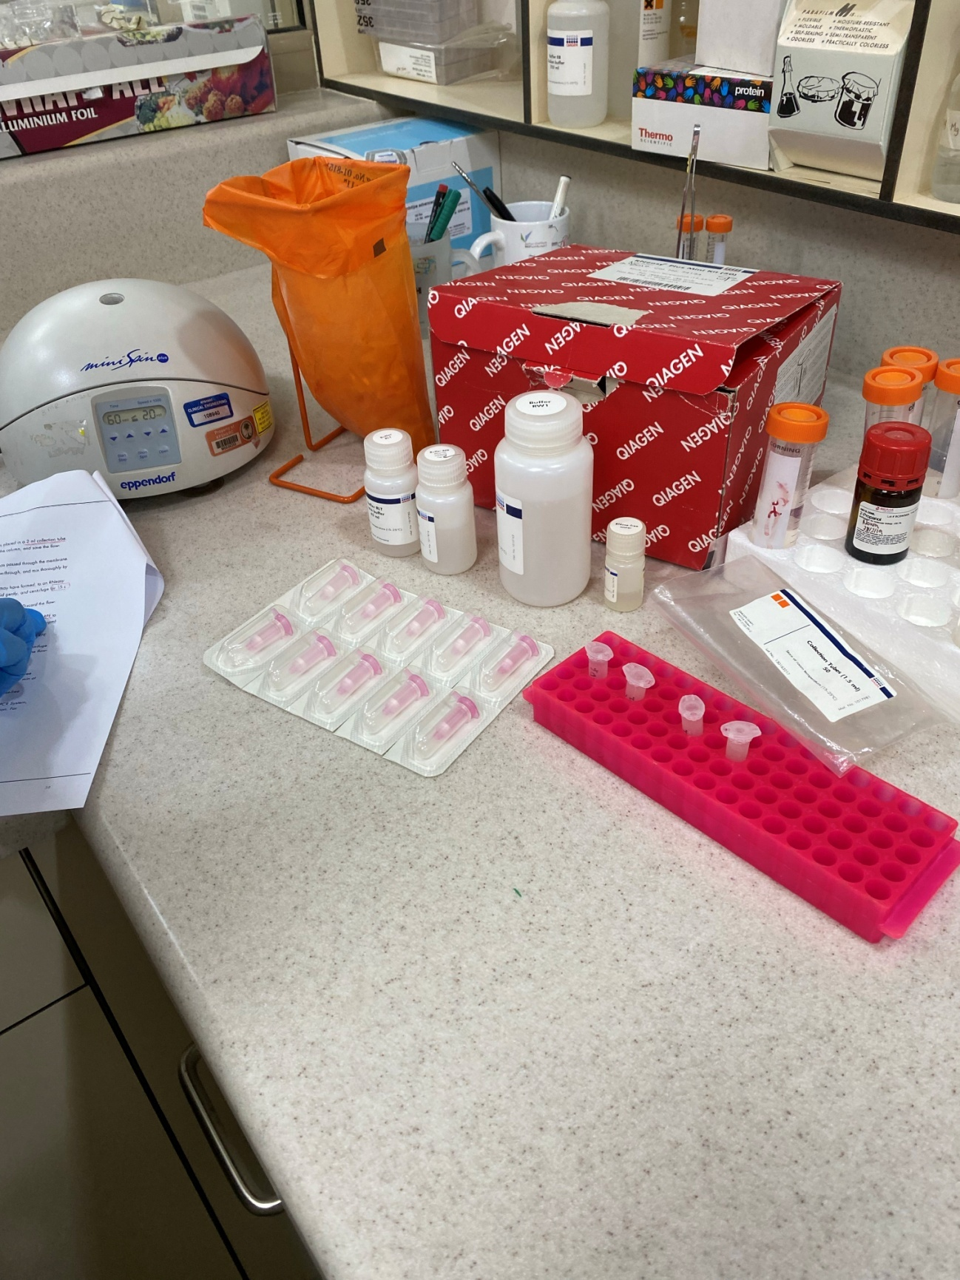
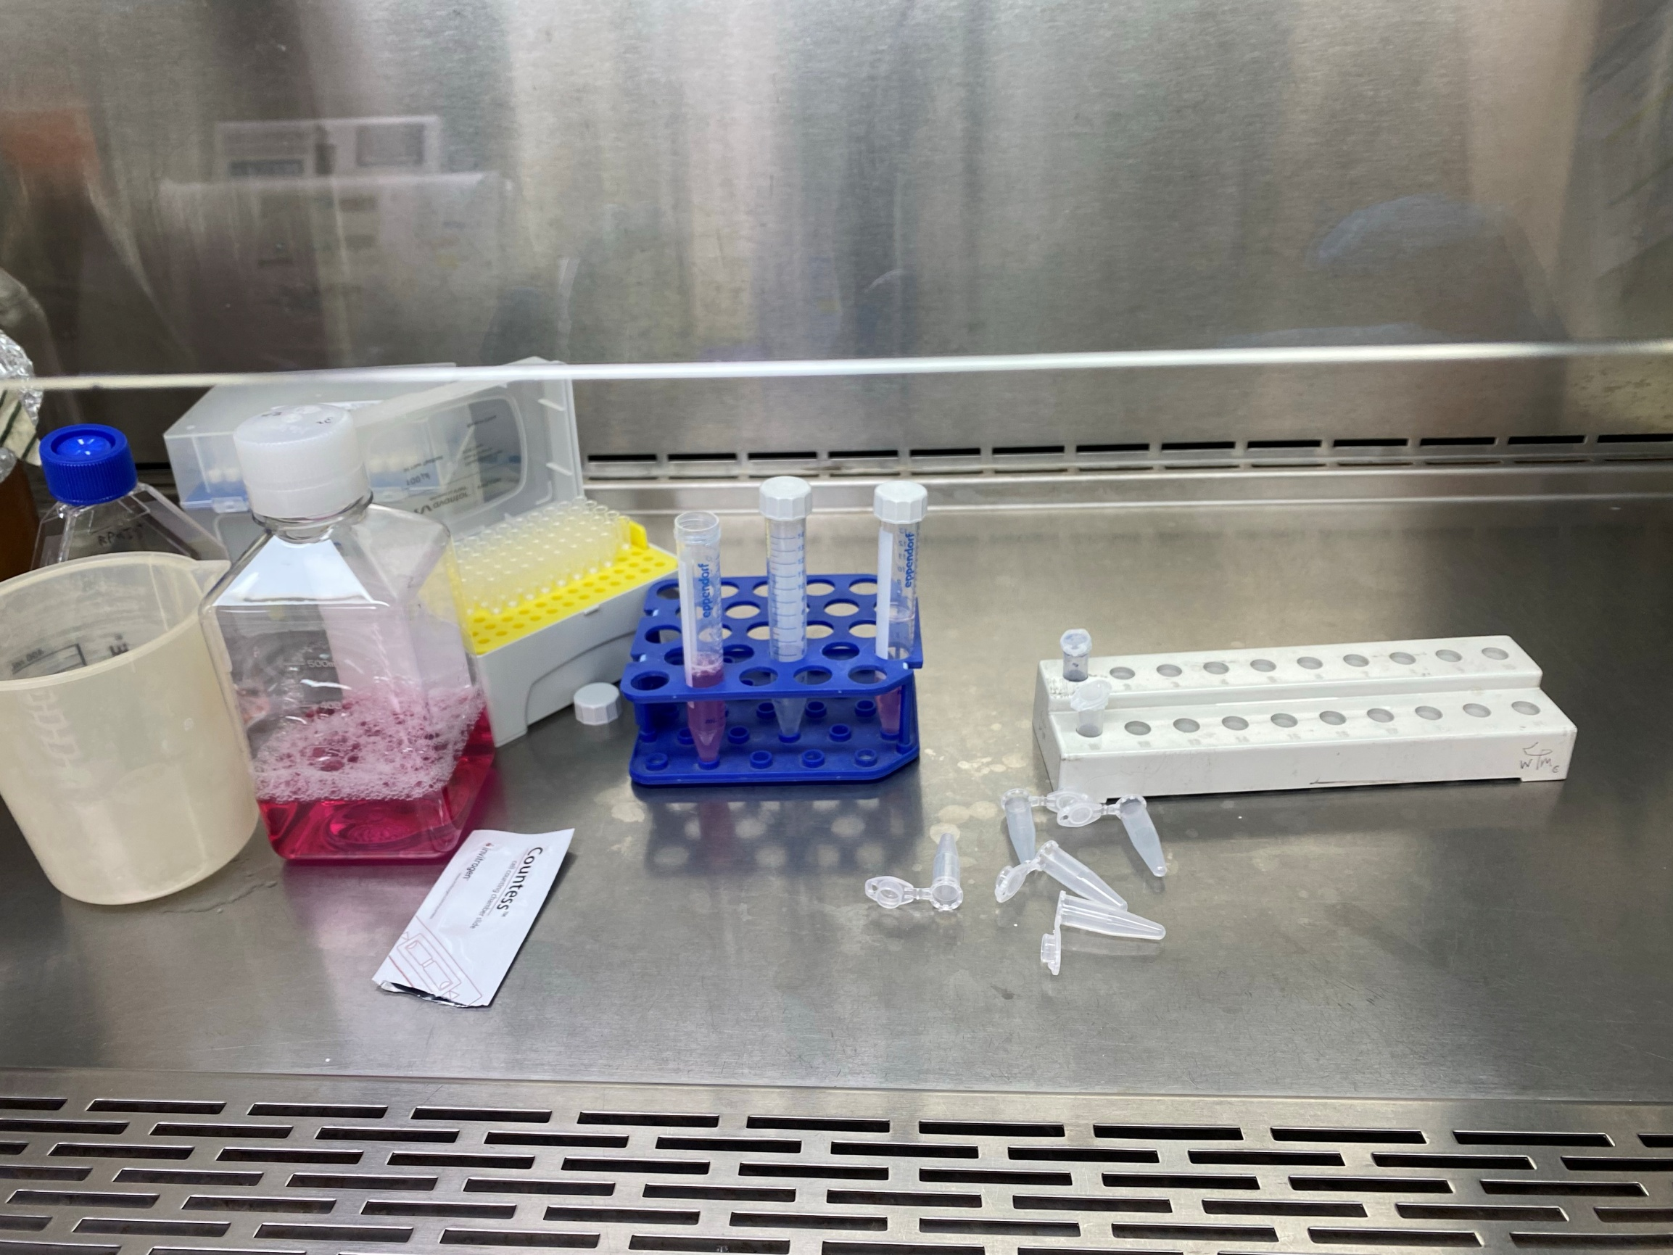
While doing the experiment

